Slide 1
Industrial Training
undertaken at
Dataguise - a PKWARE Company
Aryan Chauhan
UE193027

Slide 2

Agenda
About PKWARE
Training Details
Pro Foods
Software Requirement Specification
Software Design
Technologies Used
Project Demo
Conclusion

Slide 3

About PKWARE
PKWARE Inc. is an enterprise data protection software company that provides discovery, classification, masking and encryption solutions, along with data compression software, used by thousands of organizations in financial services, manufacturing, military, healthcare and government. These solutions are used by enterprises that need to comply with data protection regulations such as GDPR, CCPA, HIPAA, PCI DSS, TISAX, ITAR, CDPA, LGPD and other emerging laws. The company is headquartered in Milwaukee, Wisconsin with additional offices in the US, UK and India.
Rebranded in 2021 after the acquisition of Dataguise, the PK Protect suite encompasses all former PKWARE and Dataguise products and offers solutions for managing personal data and other sensitive data through data discovery, classification, masking, reduction and encryption.

Slide 4
Training Details
The first 3 months of the internship is the training of the technologies used in products of Pkware. This includes: -
Java programming language (Core and Advance)
Java Database Connectivity (JDBC) and Hibernate
Spring Boot Framework
Introduction to Gradle, Tomcat server
Introduction to HTML, CSS, Bootstrap
JavaScript and typescript programming language
Angular framework

Slide 5
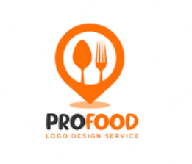
Online Food Ordering System
Manage items in cart and place orders
Manage your previous orders.
Manage Inventory for driver
Close and open Restaurant.
Manage orders with status.
Filter orders on basis of date.
View support metrics using date filters.
Item wise breakdown
Category wise breakdown.

Slide 6


Software Requirement Specification
Eclipse IDE - Eclipse is an integrated development environment (IDE) used in computer programming. It contains a base workspace and an extensible plug-in system for customizing the environment.
PgAdmin - PgAdmin is a user-friendly software tool designed for managing and administering PostgreSQL databases. It provides a simple and intuitive interface that allows users to perform various tasks, such as creating and managing database objects, executing queries, and monitoring database performance.

Slide 7


VS Code - Visual Studio Code, also commonly referred to as VS Code, is a source-code editor made by Microsoft for Windows, Linux and macOS. Features include support for debugging, syntax highlighting, intelligent code completion, snippets, code refactoring, and embedded Git.
Git and Github - Git and GitHub are powerful software tools used for version control and collaboration in software development projects. Git is a distributed version control system that allows developers to track changes, manage different versions of files, and collaborate with others efficiently. GitHub, on the other hand, is a web-based hosting service for Git repositories. It provides a platform for developers to store their Git repositories remotely and collaborate with others.

Slide 8
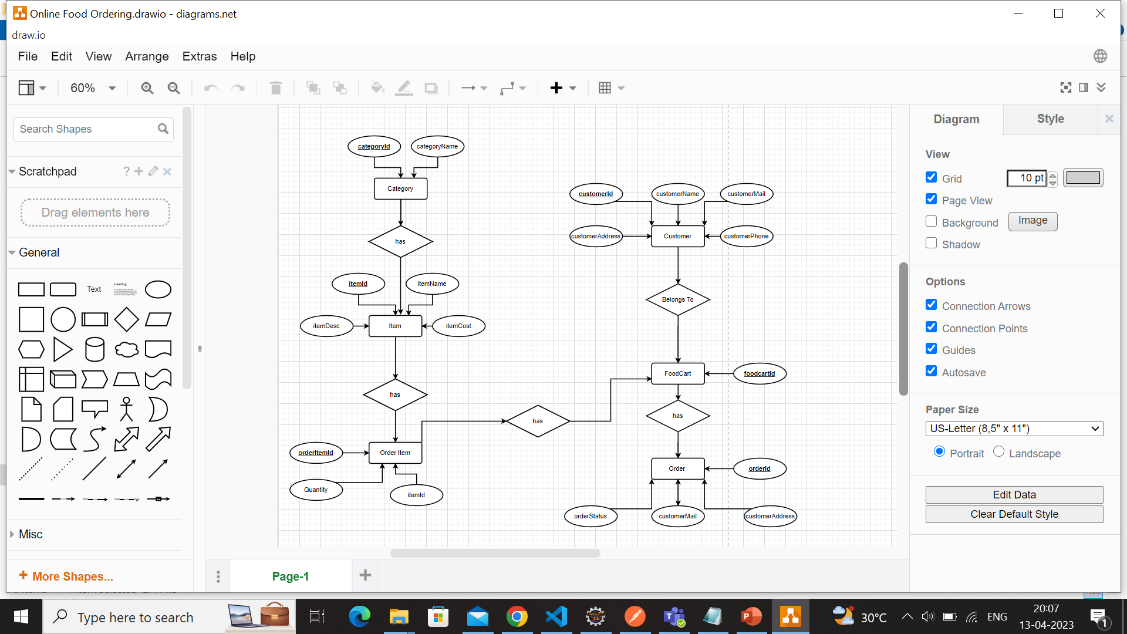
Software Design
ER Diagram

Slide 9
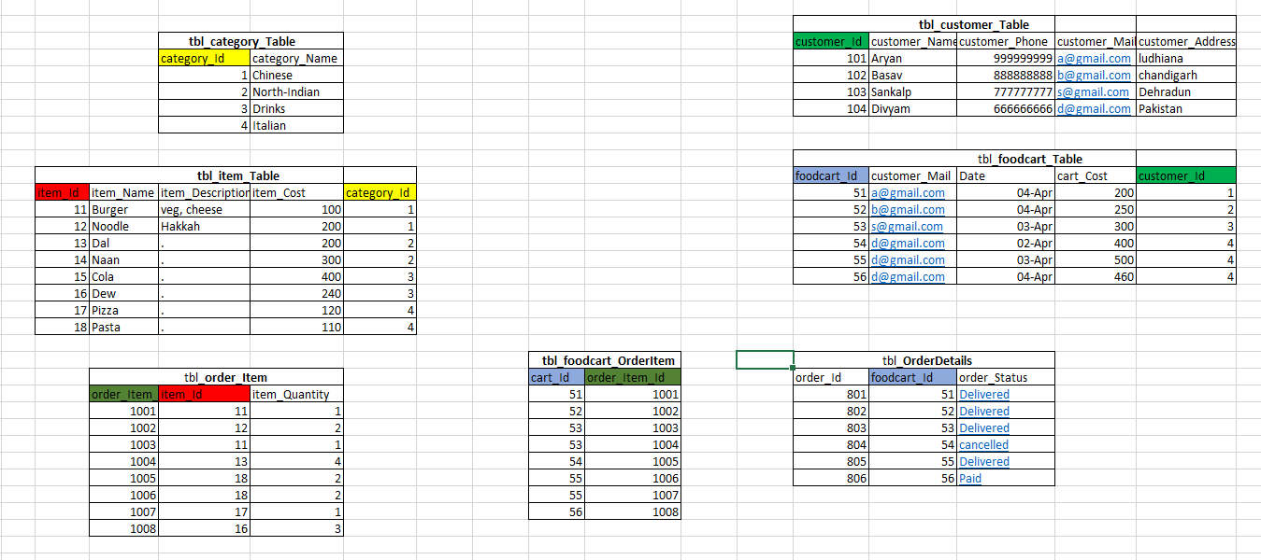
Software Design
DB structure

Slide 10

Technology Stack
Technologies Used-
Java - used in backend logic and validations.
Spring Boot - for making RESTful API’s.
Postgres Database - for storing all data.
Angular - for building frontend UI of web application.
Bootstrap - CSS styling framework.
Tools Used -
Gradle - build tool.
PgAdmin - for visualising postgres database
Git - Version control system
VsCode - IDE

Slide 11
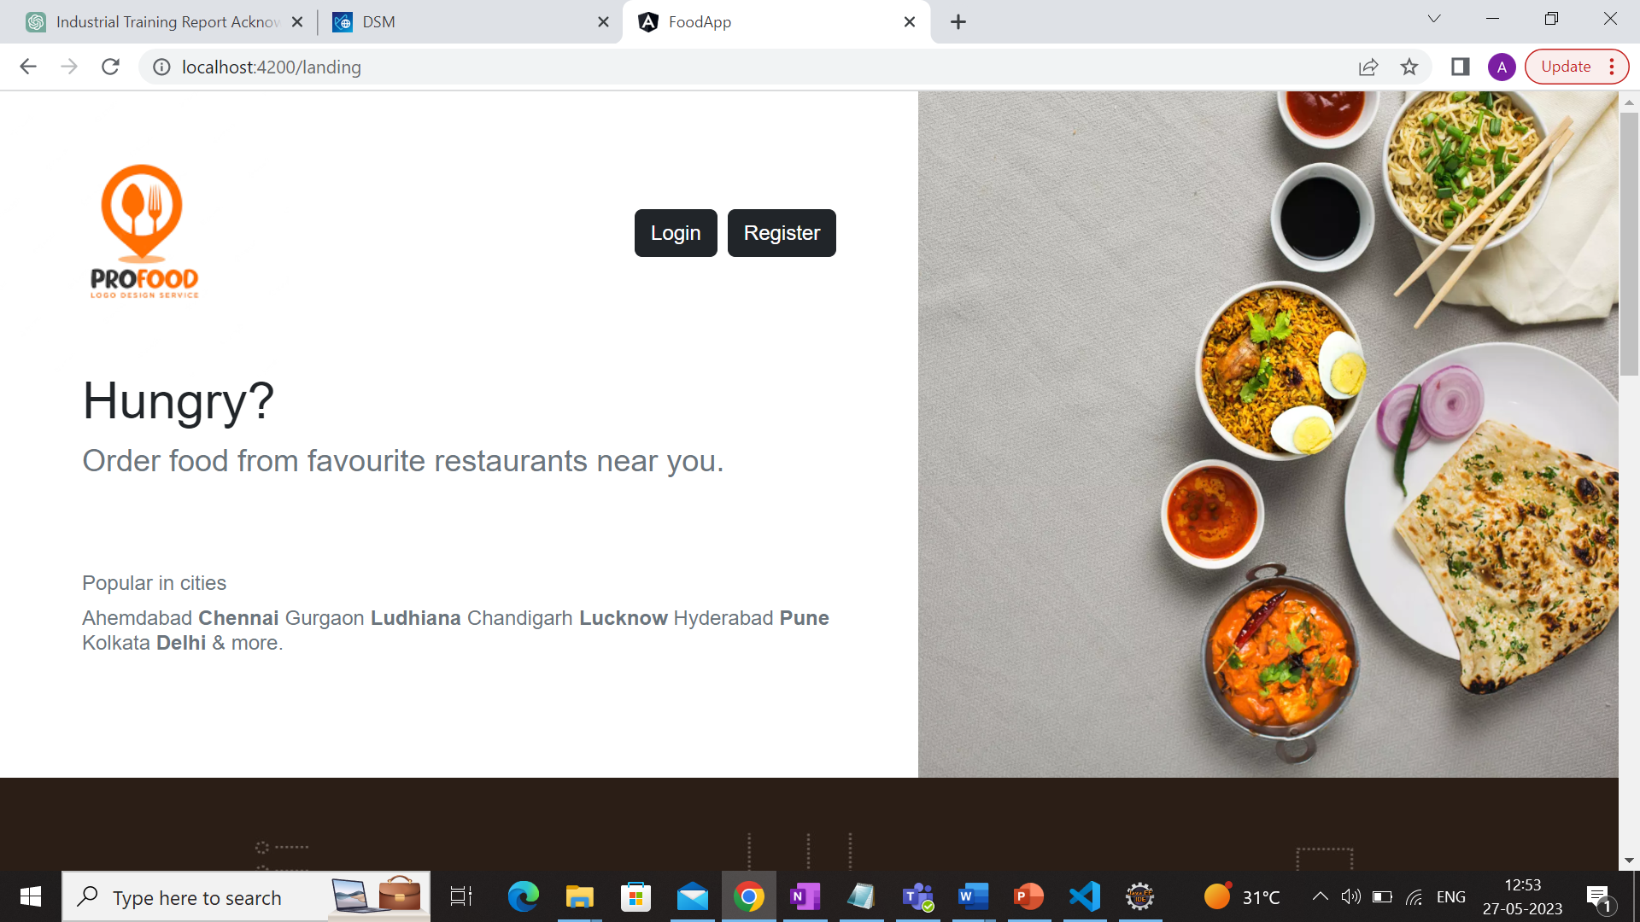
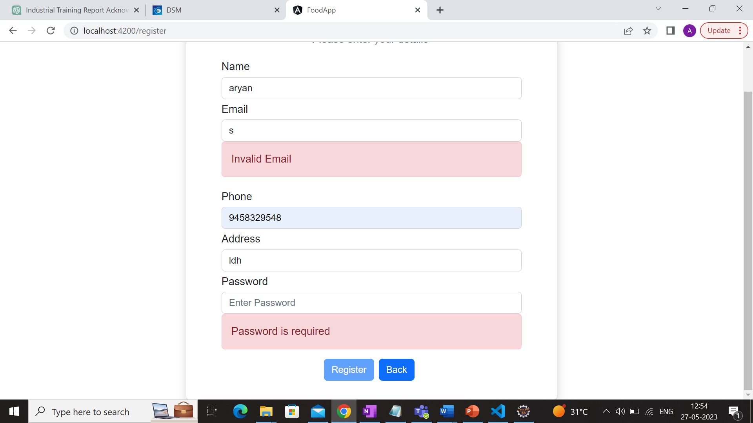
Project Demo
Landing Page
Registration Form

Slide 12
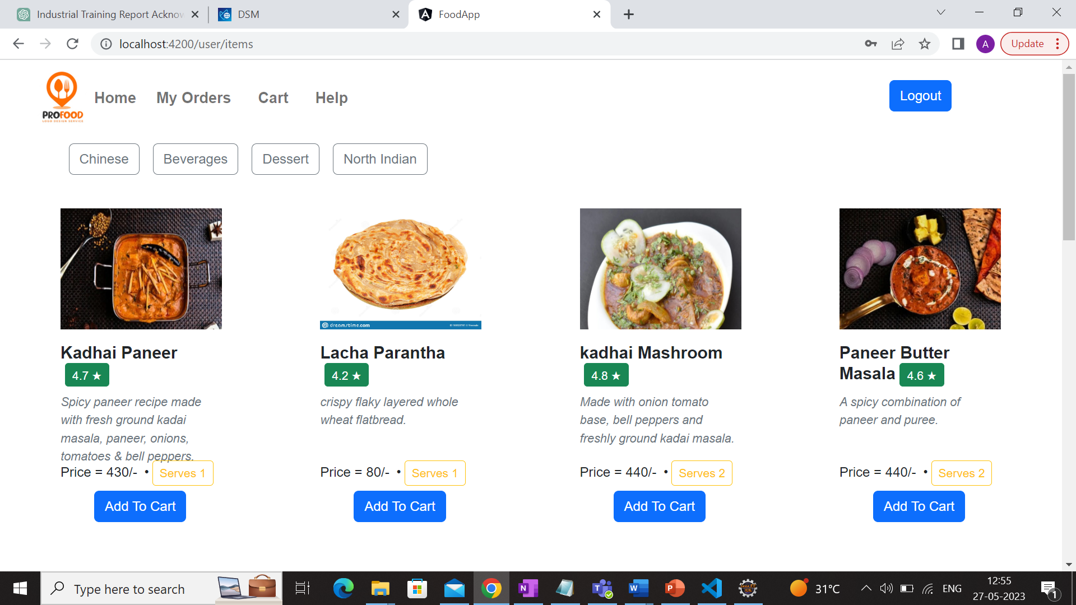
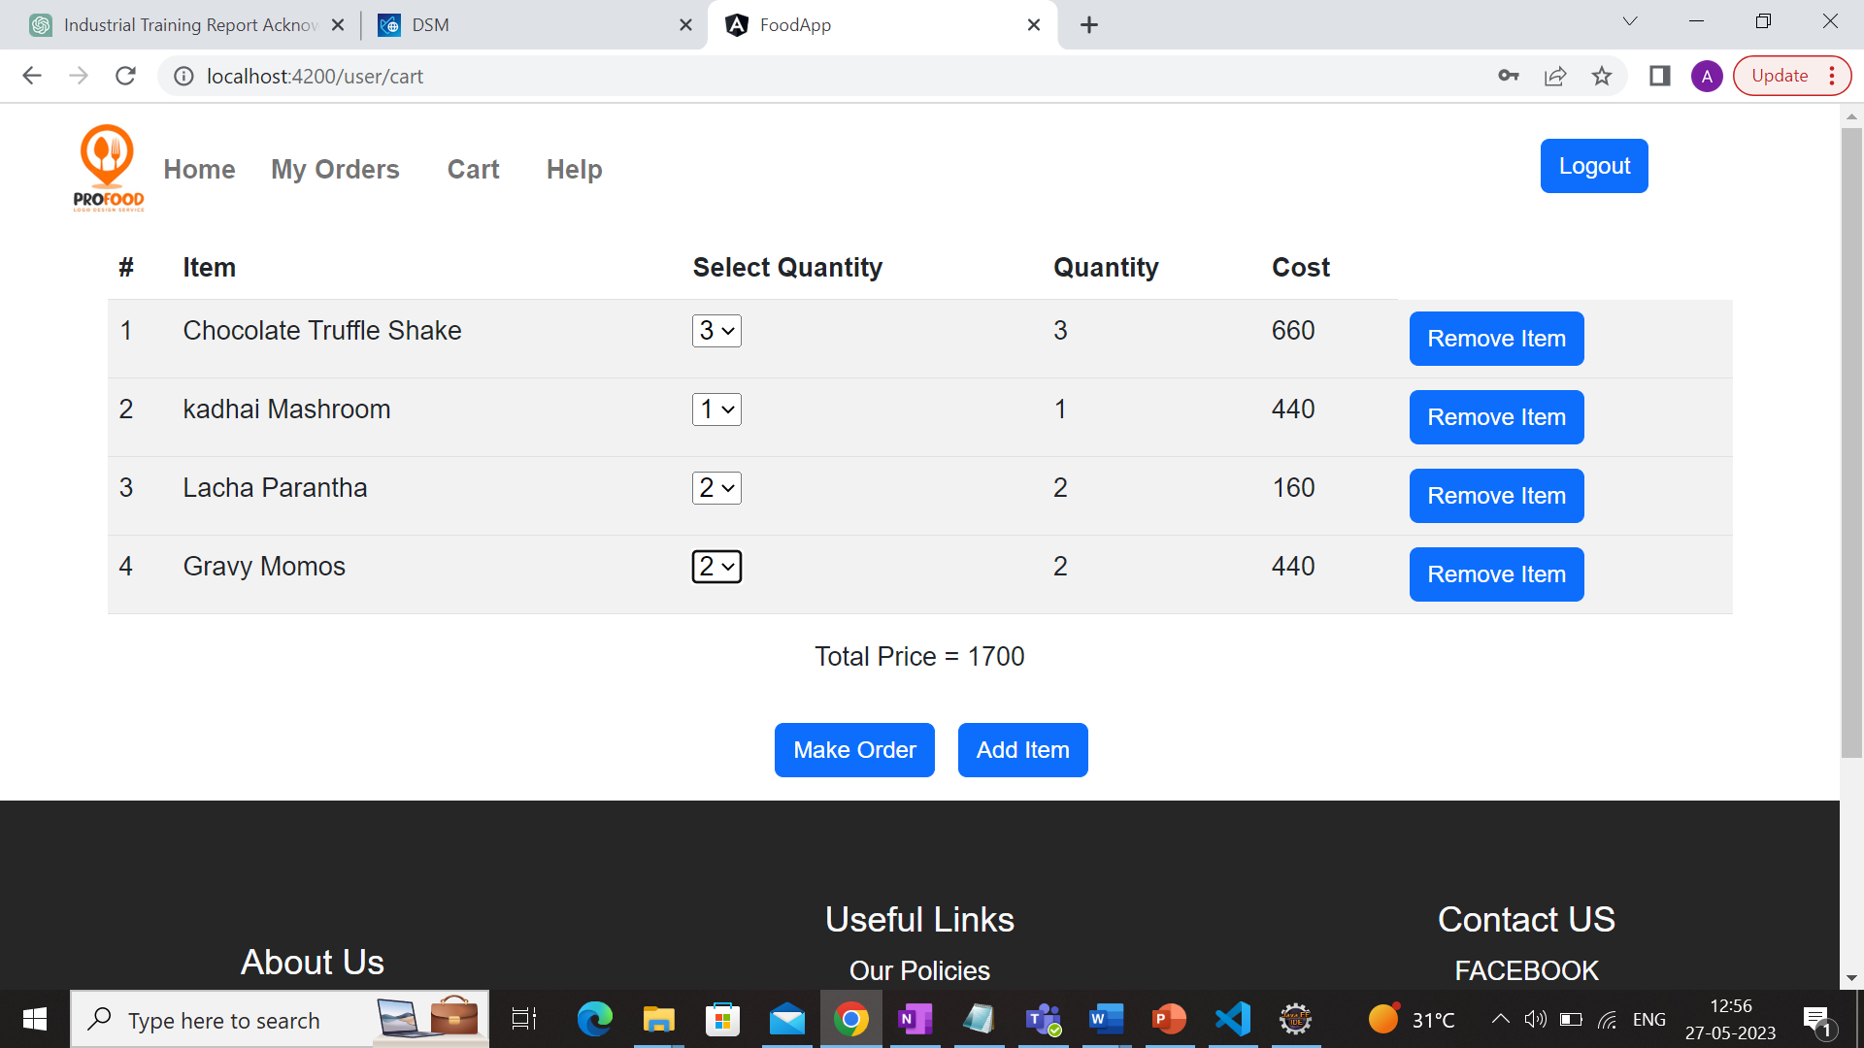
Items Page
Cart Page

Slide 13
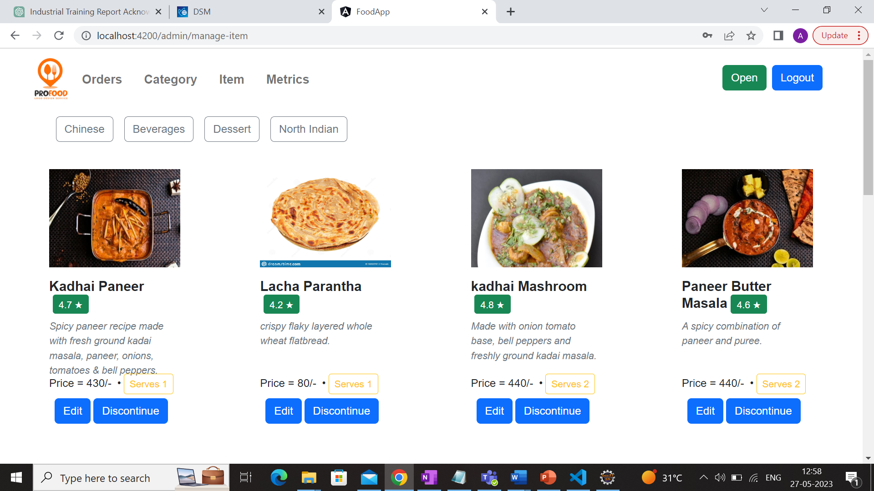
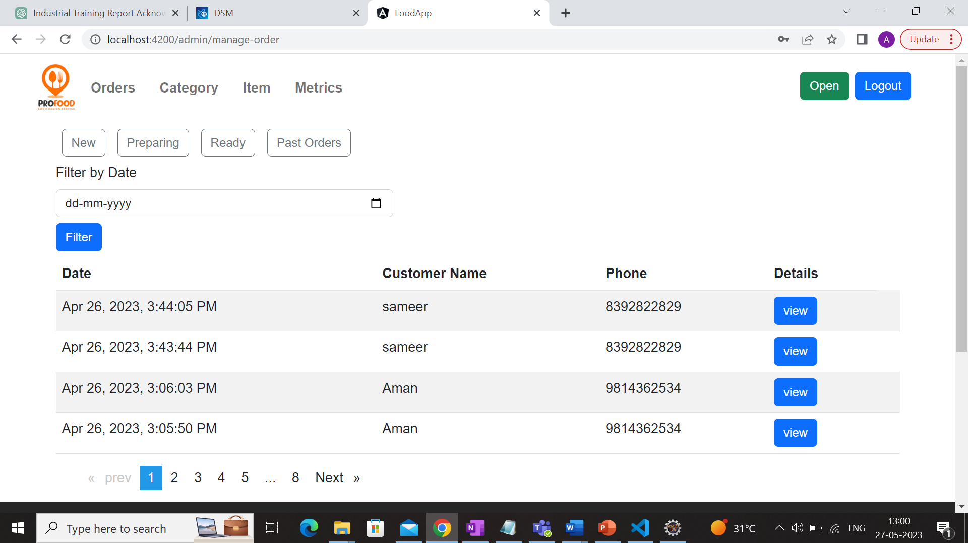
Inventory Management
Manage Orders

Slide 14
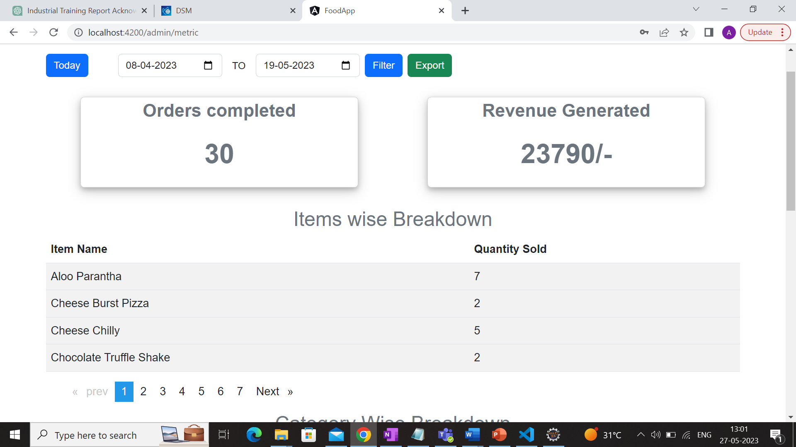
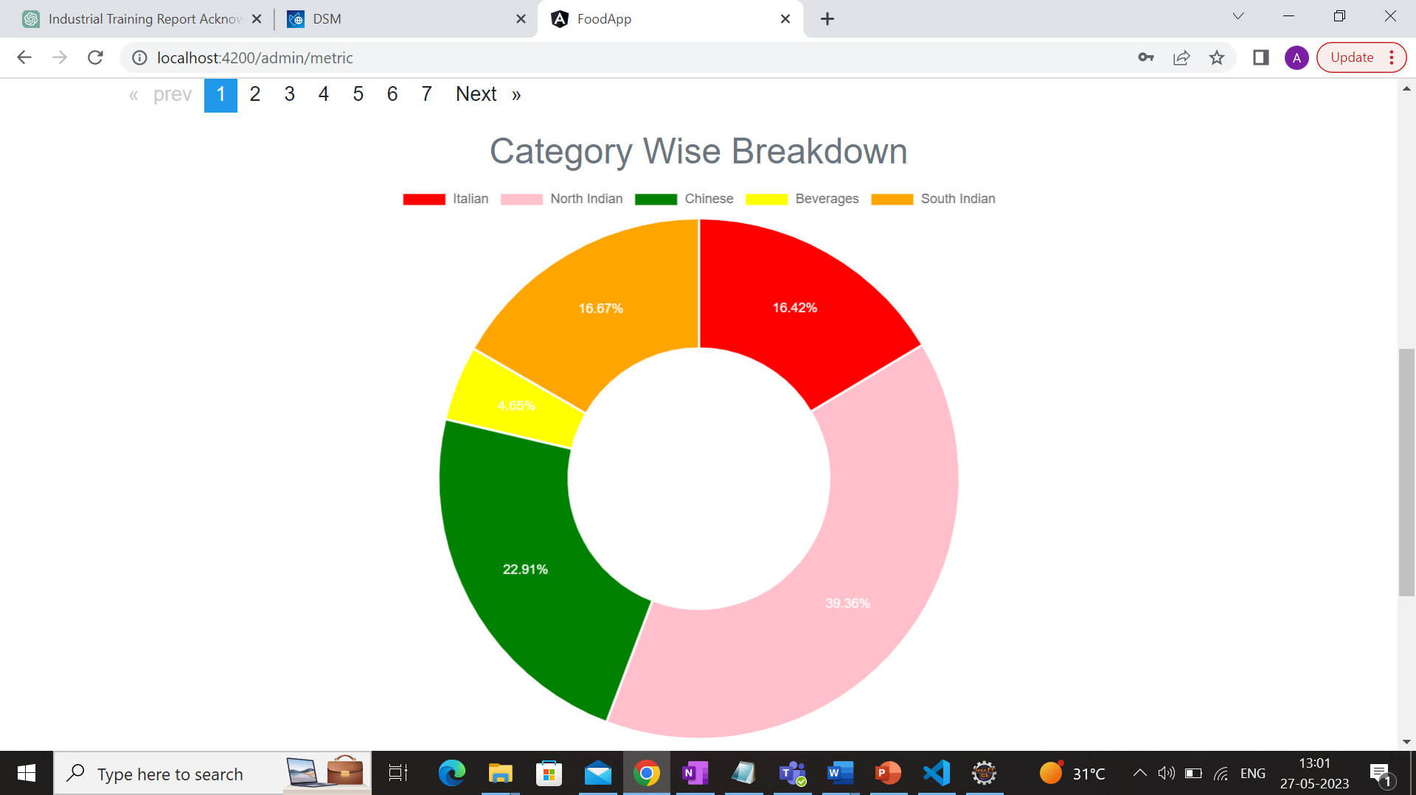
Order Metrics
Pie Chart for Category Sales

Slide 15
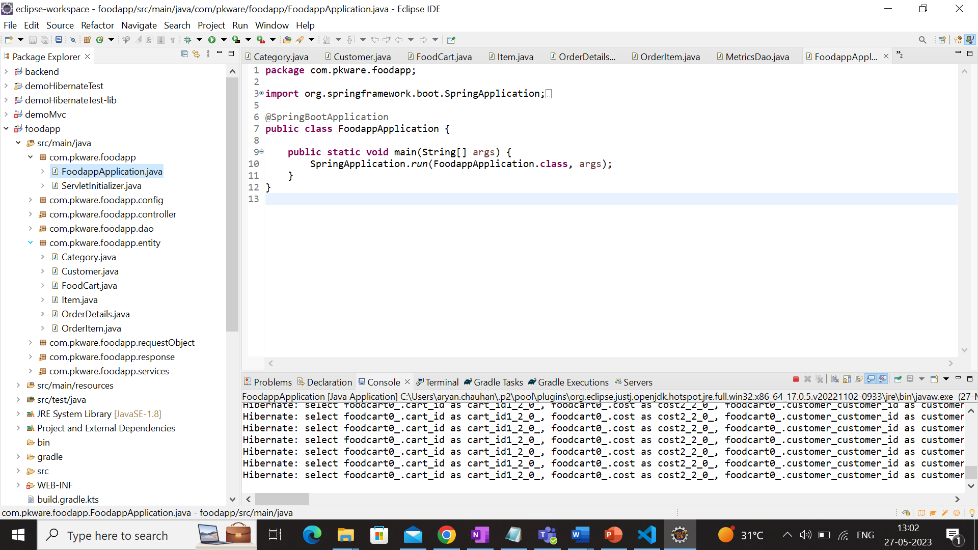
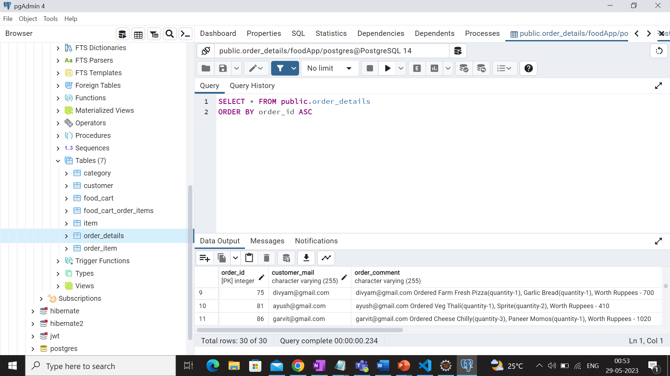
Eclipse folder structure
PgAdmin Database tables

Slide 16

Conclusion
In conclusion, my internship with Dataguise – A PKWARE Company as a Java Software Development has been a valuable learning experience that helped me develop my analytical, communication, teamwork, and problem-solving skills.
During these 4 months of Industrial Training, I have learned a lot of new and interesting technologies. It has been a really great experience to watch and learn how a company operates. Being a part of such a talented organisation filled with aspiring and encouraging people has shown me a great path for my career. I would like to learn more and more and develop new and professional skills.
I would really like to thank all the teachers and mentors and UIET, Panjab University for providing me with this opportunity to learn and grow. I am looking forward to contributing more as and when there is an opportunity where I can contribute on what I learnt and will be learning in future and make best use of the experience.

